Slide 1
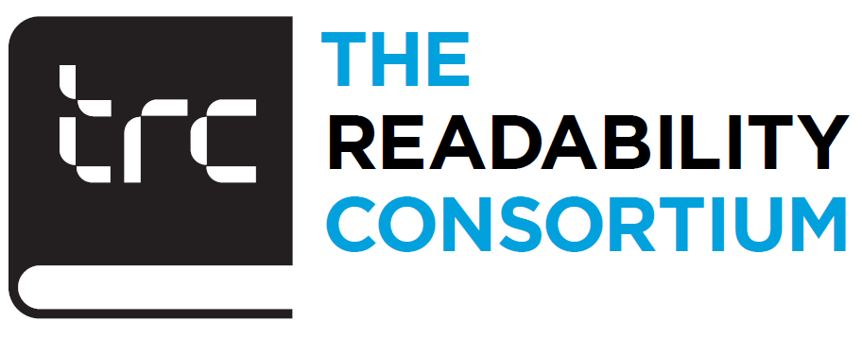
Identifying Underserved Languages
Goal: A Method for Identifying Writing Systems that are widely read digitally but have lower typographic infrastructure maturity
Outcome: evidence based prioritization for global typography investment
Deliverables: Open source (Apache 2.0) Dataset, ML model, Ranked List, TIS heatmap, Recommendation white paper
Pilot Scripts: Top 8 scripts except Latin by population of main countries
Unknowns:
What causes an underserved language to have a font developed for it?
If you had to operationalize “underserved” into metrics, what signals would matter most?
If we had a model that compared readability robustness across scripts under degraded conditions, would that be useful in your workflow?
How are script investment decisions currently made; customer-driven, region-driven, or engineering-driven?
Presented by
Aditya Khadye
Lou Vaughn
The Readability Consortium
January
2026
Notes:
Are there scripts that don’t look big on paper but generate disproportionate engineering effort?
If you had to operationalize “underserved” into metrics, what signals would matter most?
If we had a model that compared readability robustness across scripts under degraded conditions, would that be useful in your workflow?
How are script investment decisions currently made; customer-driven, region-driven, or engineering-driven? If so, where?, For a 4-month project, what would you focus on first if you were me?

Slide 2
